Slide 1


Green Pace
Security Policy Presentation
Developer: Shaun Rester

Slide 2

OVERVIEW: DEFENSE IN DEPTH
Our goal is to mainstream security here at Green Pace. We are establishing multiple layers of security around all aspects of the company. Physical, cloud, network, etc. will all be layered to protect from threats. By layering each individual type of security with its own layers we will establish multiple redundancies throughout our code by utilizing the basic DiD method.

Slide 3
THREATS MATRIX
Likely These are threats that are most likely to occur. STD-004-CPP STD-004-CPP STD-008-CPP STD-010-CPP | Priority These are standard threats have the highest priority. STD-004-CPP STD-004-CPP STD-008-CPP STD-010-CPP
Low priority These are standard threats that are least relevant, even still we believe all threats should be handled. STD-001-CPP STD-005-CPP STD-006-CPP STD-007-CPP | Unlikely These are threats that serve as a general warning but are usually not likely to occur. STD-001-CPP STD-005-CPP STD-006-CPP STD-007-CPP

Slide 4
10 PRINCIPLES
1. Validate Input Data | Verify that any untrusted datas inputs are being validated that helps us establish the use of proper input. This helps prevent SQL injection, all data sources should be validated especially in the case of external data.
2. Heed Compiler Warnings | Warnings are given for a reason making sure to look into each warning and developing code accordingly is important. Leaving warnings can lead to security risks, we should assume that the warning given to the code is the highest security risk for that specific warning.
3. Architect and Design for Security Policies | Software needs to be established with security measures in mind. If you are not focusing on security throughout every step you are leaving the chance open of having unsecure code.
4. Keep It Simple | With complex code comes harder to implement security measures on top of it being easier to make mistakes during the design process. Make your code as simple as possible don’t add extra unnecessary steps.
5. Default Deny | Establish a specific way things need to be handled when or done when it comes to authorizations and permissions. By default denying unless specific parameters are met that gives you an added layer of security by verifying things are done as you intended.
6. Adhere to the Principle of Least Privilege | Keep the privileges minimalistic, only give access or privilege when necessary. Even with utilizing higher access processes set specific time limits to give attackers smaller margins to work with when attempting to hack the system. Having limited access helps reduce the vulnerability risks.
7. Sanitize Data Sent to Other Systems | Sanitization helps to protect from Injection attacks. Any data being sent to other systems should be sanitized in advance. This is usually handled by deleting or removing data stored on a specific device.
8. Practice Defense in Depth | Practicing defense in depth is always a positive. Utilizing multiple layers of security helps fortify your system because when one layer gets passed another takes its place.
9. Use Effective Quality Assurance Techniques | Utilizing proper QA techniques helps to insure your security is functioning as expected. Testing techniques like fuzz and penetration testing helps you verify on your end, reviewing, and getting input from an outside source gives you I birds eye view of potential concerns.
10. Adopt a Secure Coding Standard | Establish your own or find a secure coding standard to adapt to your coding style. Make sure you take your language and specific needs into consideration. But with out a set structure and establishing secure practices you leave yourself open to minor mistakes that can lead to security issues. Consistency is key.

Slide 5
CODING STANDARDS
Data Type - Converting a pointer to integer or integer to pointer.
Data Value - A value-returning function must return a value from all code paths; otherwise, it will result in undefined behavior.
String Correctness - Use valid references, pointers, and iterators to reference elements of a container.
SQL Injection - String data passed to complex subsystems may contain special characters that can trigger commands or actions, resulting in a software vulnerability. As a result, it is necessary to sanitize all string data passed to complex subsystems so that the resulting string is innocuous in the context in which it will be interpreted.
Memory Protection - Clear sensitive information stored in reusable resources.
Assertions - When working with constant expressions utilize static assertion methods to test values.
Exceptions - Handle all exceptions.
Containers - Guarantee that library functions do not overflow.
Expressions - Do not rely on the value of a moved-from object.
Miscellaneous - Ensure your random number generator is properly seeded.

Slide 6
ENCRYPTION POLICIES
Encryption in rest - Encryption at rest is encoding and protecting data that is stored. Having encryption on any sensitive data being stored is vital for apps that deal with cc information, names, DoB, as well as addresses. Just because information isn’t currently or won’t be required in the immediate future doesn’t mean attackers will not pursue it. Decryption only occurs when the data is being pulled from the proper authorized individuals.
Encryption at flight - Encryption at flight is a security measure that encodes and protects data that is in transit. There will be different steps depending on what type of data is being handled. Using secure protocols such as encryption and digital signatures to verify who is handling things at every moment.
Encryption in use - Encryption in use is establishing protection levels for our data within allocated memory sections. This is established with password protection as well as encryption keys which encode sensitive information. This helps protect both data in flight and at rest.

Slide 7
TRIPLE-A POLICIES
Authentication – Authentication is the process utilized to verify specific users. They accomplish this by establishing userID, passwords, and in some instances pins and tokens could be utilized.
Authorization – Authorization is the step after authentication. When users are properly verified authorization allows them to gain access to specific elements of the application(whatever their role has rights too). This could be folders, reading, and even modifying up to a degree.
Accounting – Account is the process of verifying who has attempted to or has successfully gained access to the system and what they were doing or attempting to do with their access. This is accomplished by monitoring and recording individual users and their activity while on the system.

Slide 8
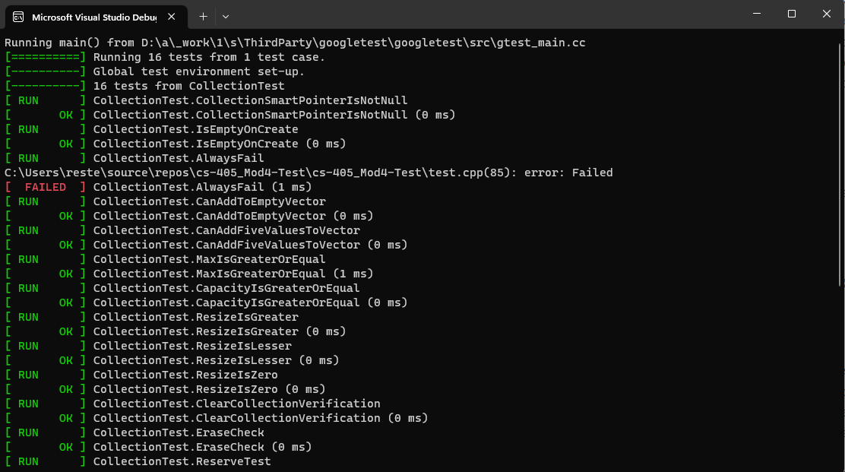
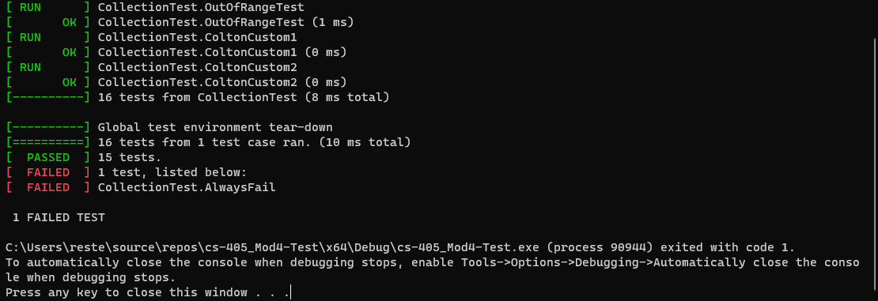
Unit Testing
Unit testing is handled early on throughout the process. This is an example of the google tests we were utilizing to verify establishing, adding, and removing values from a table as well as establishing if they are positive integers.

Slide 9

AUTOMATION SUMMARY

Slide 10
TOOLS
DevSecOps Pipeline is a theory that adopts the DevOps security processes. The twist they add to this process is they create it as a continuous system, constantly delivering and sending new updates. It is used to create an SDLC application that has security as the focal point.Automation has many positives for each step of the design, implementation, and maintenance steps of the application life-cycle. Mostly due to the fact that every aspect in this cycle should have some form of testing to verify the pieces are working properly, we can establish automated tests to do this. We can also use automation for the gathering of information for the application to help keep us in the loop without requiring constant verification and data collection from a human. I feel as though properly implementing automation into our application will help us make a more secure and efficient product.

Slide 11
RISKS AND BENEFITS
When it comes to act now or wait there will always be concerns and questions. The problems that come with waiting is the potential risks skipped over, and the time required to now go back and fix issues that could have been remedied during the process. The solution that comes with this is the now, working on the errors during their respective steps saves us time and energy not having to back track or redeploy anything. Assuming that there is always a potential concern or that any minor warning could be a major problem is known as the zero-trust policy which helps us focus on negating vulnerabilities. Establishing multiple redundant layers of security is known as Defense-in-Depth, which helps establish multiple layers of security.

Slide 12
RECOMMENDATIONS
Major focal points for us currently should be maintaining the levels of security we have been incorporating and building upon them. Utilizing Defense-in-Depth we can establish multiple redundancy layers which will help protect our application by having fail safes. Also the utilization of automation will help us to more efficiently keep up with any changes/updates required in our security systems.

Slide 13
CONCLUSIONS
We have covered a good portion of preventive measures for future problems. Establishing automation techniques will help in implementing and maintaining security measures more efficiently. Establishing proper training for employees will help keep the software secure and efficient. Utilizing the zero-trust policy is the main way to keep moving forward with our security measures, if we are always questioning and always looking for the safest way to establish code we will consistently have high levels of security. Keeping our code as simplistic as possible while still maintaining functionality is also a must.

Slide 14
REFERENCES
Lawton, G. (2020). How to Prevent Accidental Complexity in Software Development. TechTarget.com. https://www.techtarget.com/searchsoftwarequality/tip/How-to-prevent-accidental-complexity-in-software-development
Rester, S. (2023). Green Pace Secure Development Policy. Unpublished Manuscript, Southern New Hampshire University.

